Slide 1
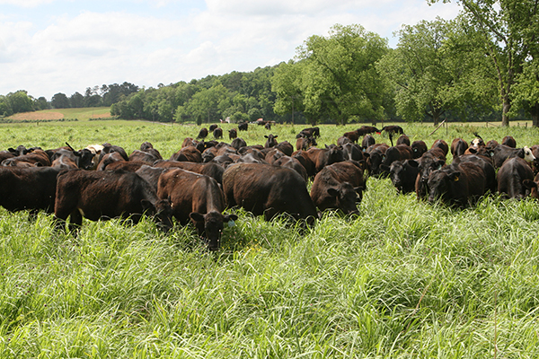
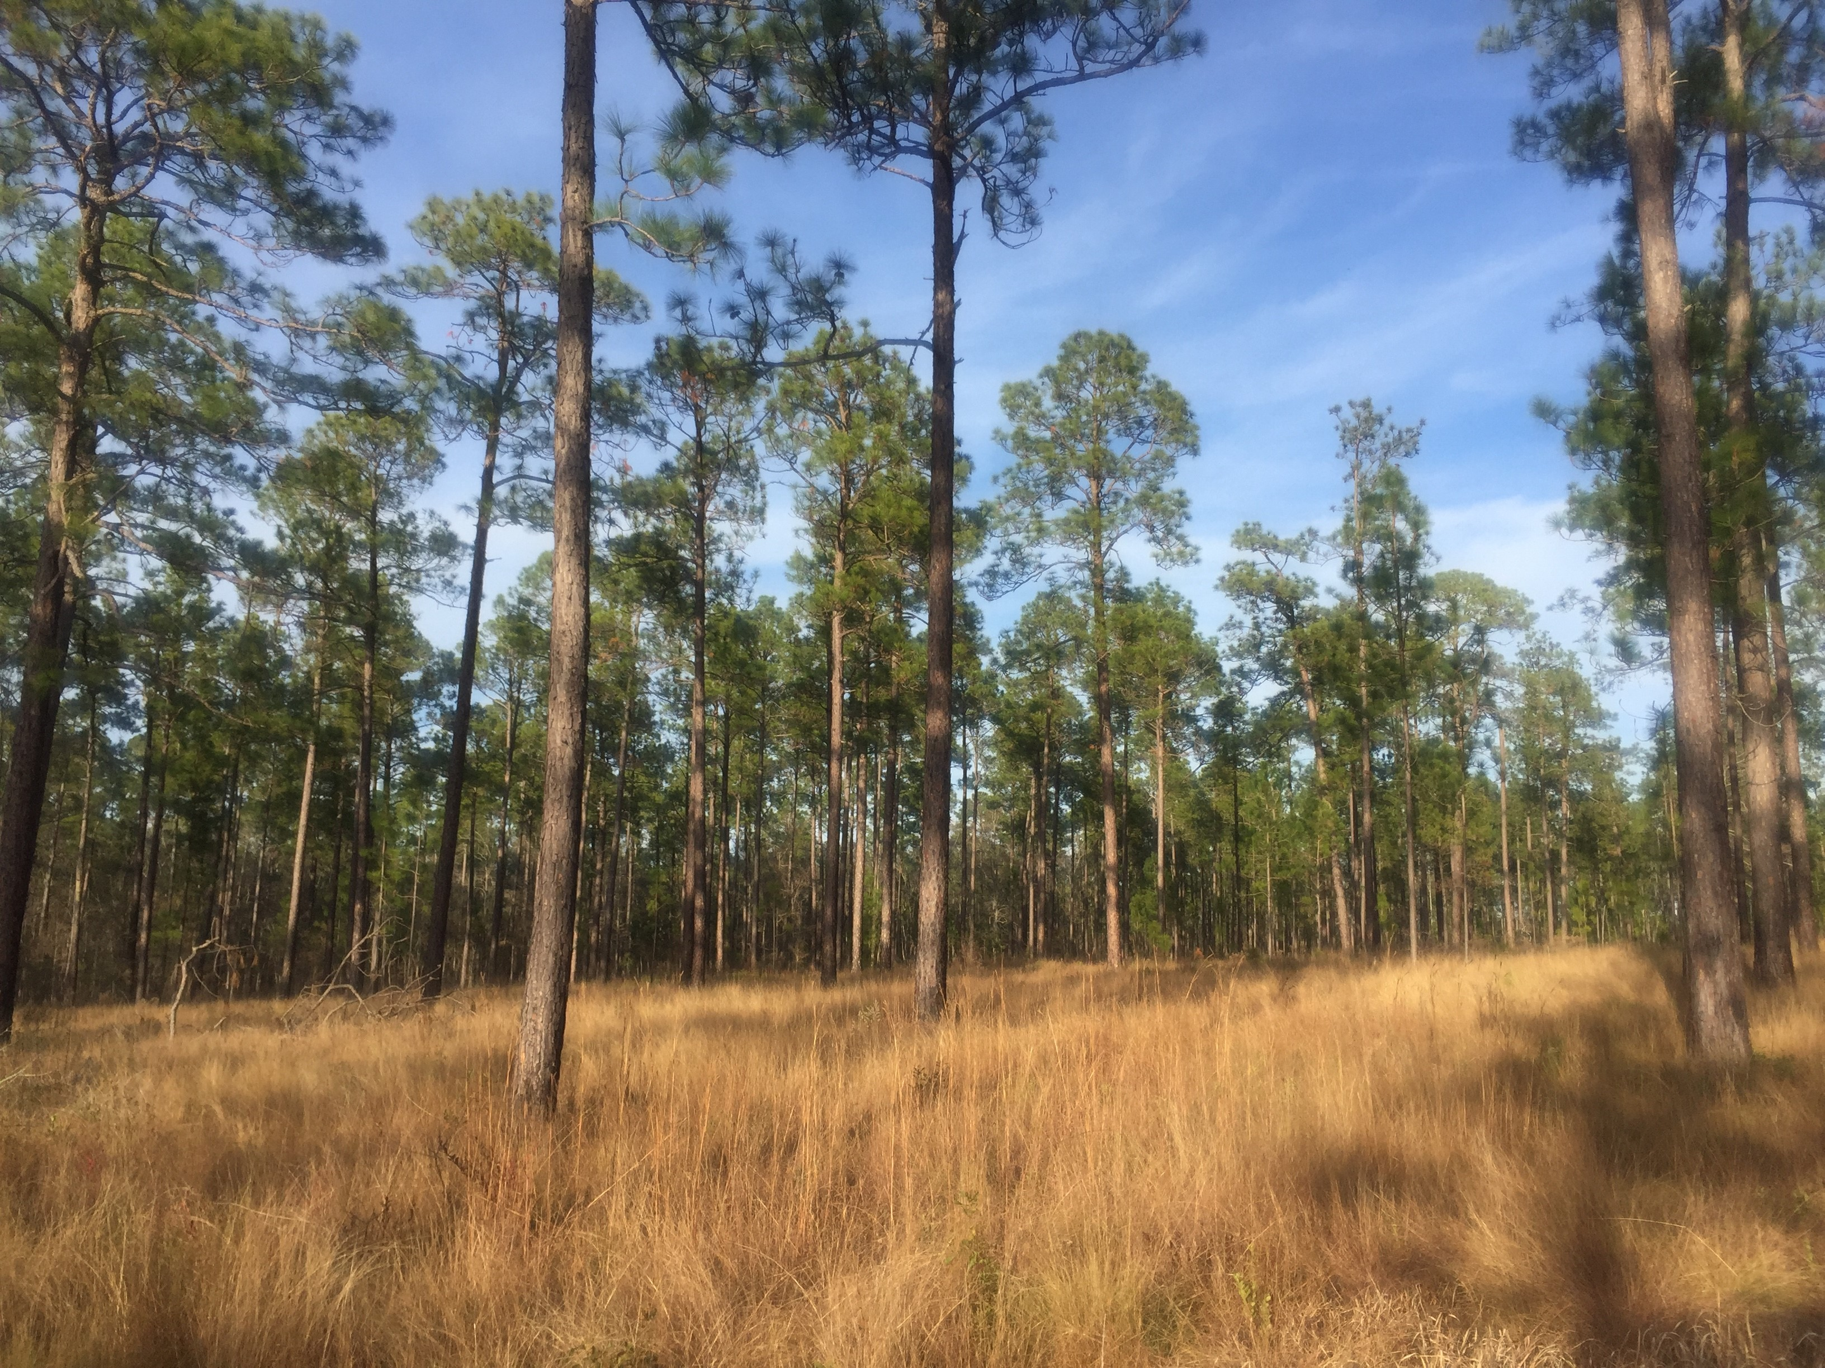
Northern Bobwhite, Grasslands & Savannas Framework
Bridgett Costanzo
Working Lands for Wildlife
Coordinator- Northern Bobwhite

Slide 2
WLFW-NOBO truly “bottom-up!”
2011
States nominate NOBO as a WLFW national target species
2017
States & partners propose NOBO as WLFW partnership;
funded by state EQIP allocations
2019
QF & AFWA petition NRCS to do more for NOBO recovery
2020
In response, NRCS releases NB- 300-21-14 LTP

Slide 3
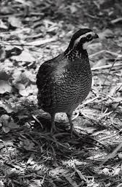
Why Northern bobwhite?
Iconic rural game species
30-year decline despite NBTC efforts
indicator species (Crosby 2015, Rosenblatt 2021)
Strong ag/forestry producer support

Slide 4
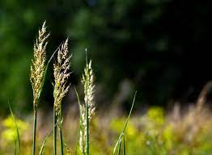
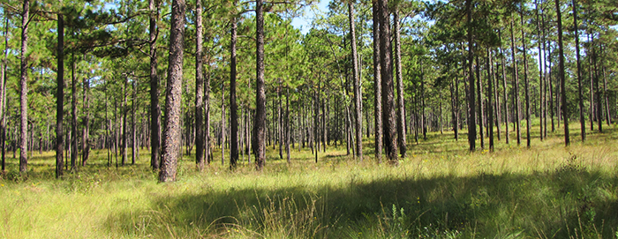
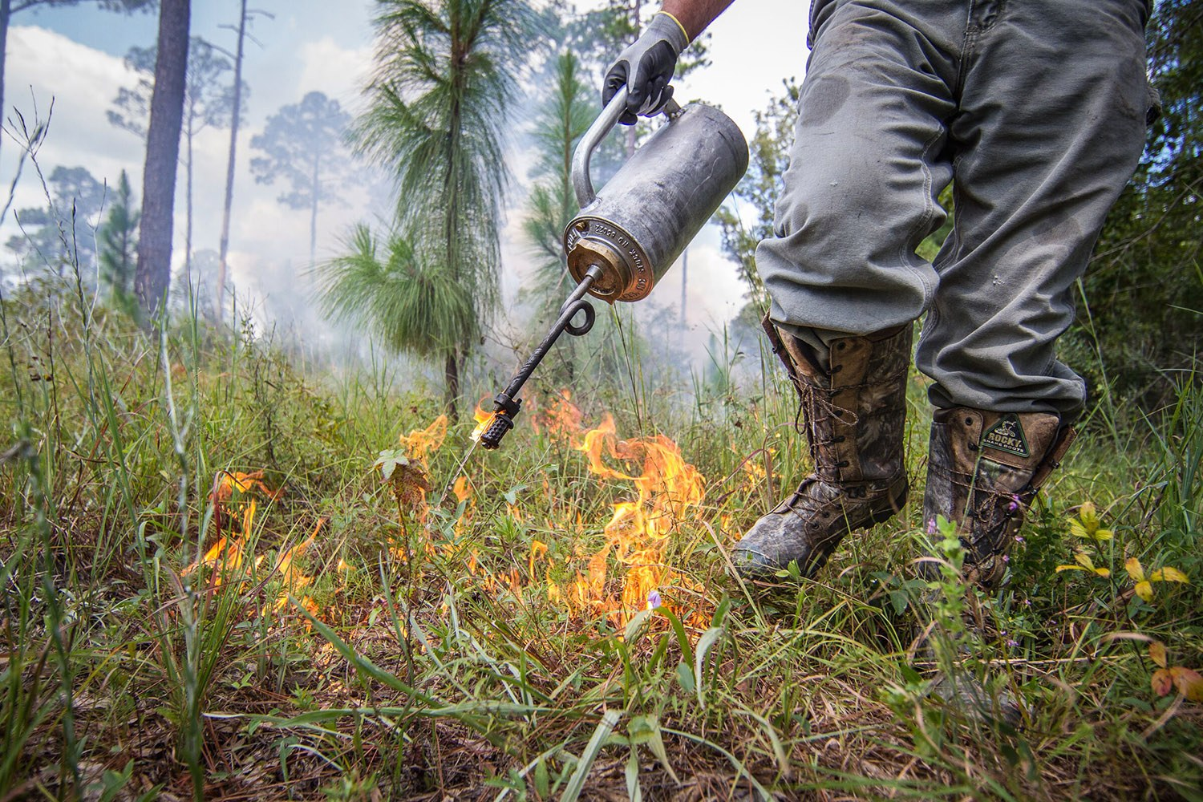
NB- 300-21-14 LTP (Feb 2021)
Address WLFW tagging issues CD
Develop Range-wide NRCS Goals
Conduct Needs Assessment
Notes:
Posted FEB 2021

Slide 5
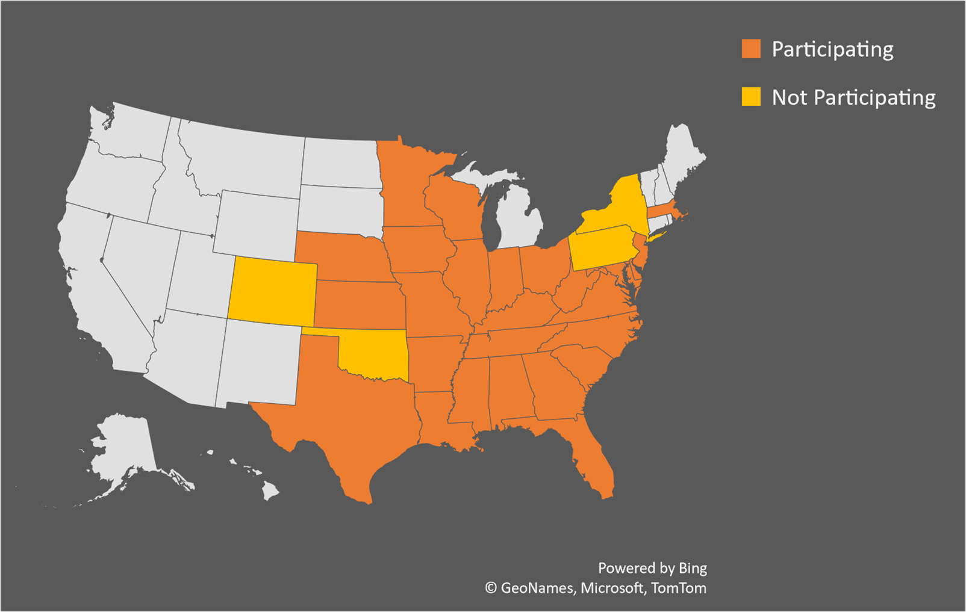
FRAMEWORK STATES
Notes:
States opting IN/OUT; OK joined in 2022!

Slide 6
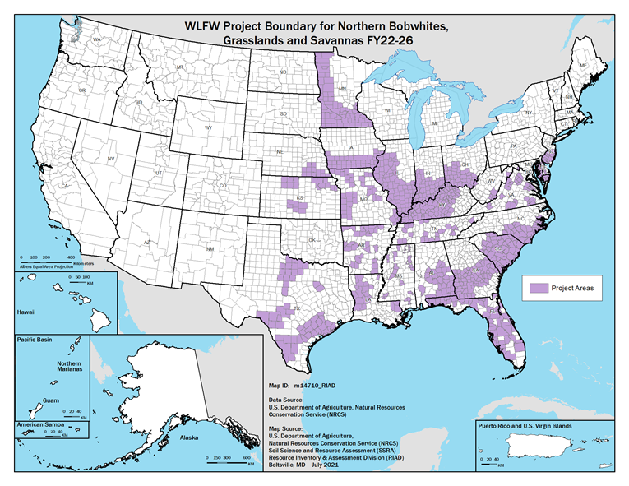
States & Local Partners ID’d
Notes:
This is the project boundary for the framework; some states have priority areas identified within larger boundaries.

Slide 7
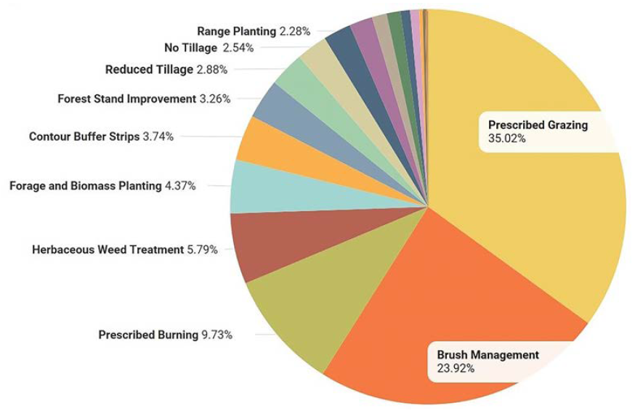
States set 5-YR Goals: 7M acres
Notes:
Top 10 CPs selected nationally; these vary significantly by region and those pie charts are presented in the framework document. For example, prescribed burning is #1 in the SE.

Slide 8
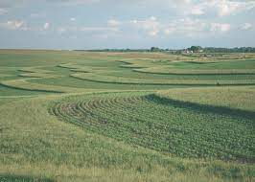
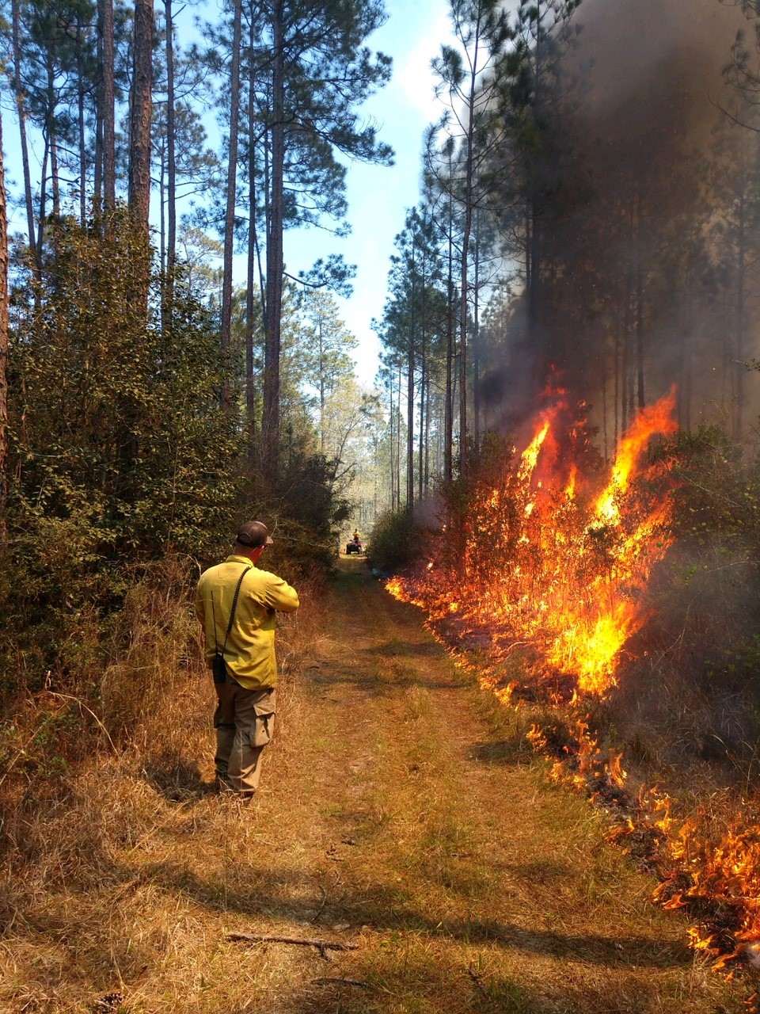
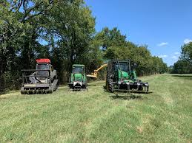
TARGETED CPs
PRECISION AG
PRESCRIBED BURNING
BRUSH MANAGEMENT

Slide 9
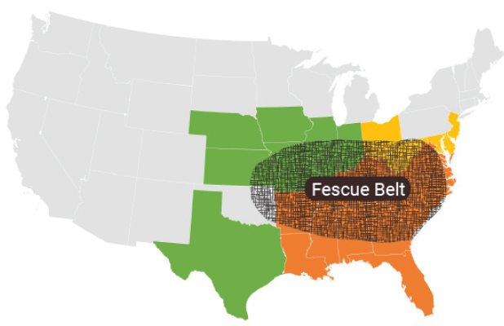
Restoration of Native Grasslands
Notes:
highest concentration of livestock producers
Work to develop alternative native forage to address summer slump
TX warmer temps/more frequent and severe droughts = NWSGs are gaining more attention.

Slide 10
S2S + TRAINING
Notes:
Early in this effort ag economist compared non-native to native forage; weight gains across the board; WLFW hosted UT Center for Native Grasslands & NBCI – deeper dive into forage economics;1000 participants in 3 weeks for recent training! See landscapepartnership.org/learning network.

Slide 11
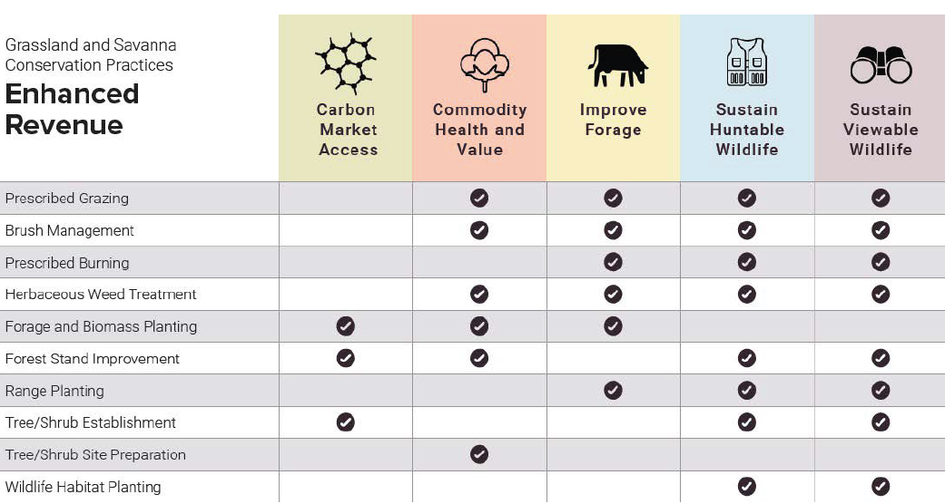
NEW: OUTCOMES ANTICIPATED
Notes:
So What? NEW – ANTICIPATED economic, wildlife and landscape resiliency outcomes based on survey of experts in ag economics, forestry, grazing, and other specialists. Revenue enhancements for producers will range from improving access to carbon markets to improving timber and herd values, to wildlife outcomes.

Slide 12
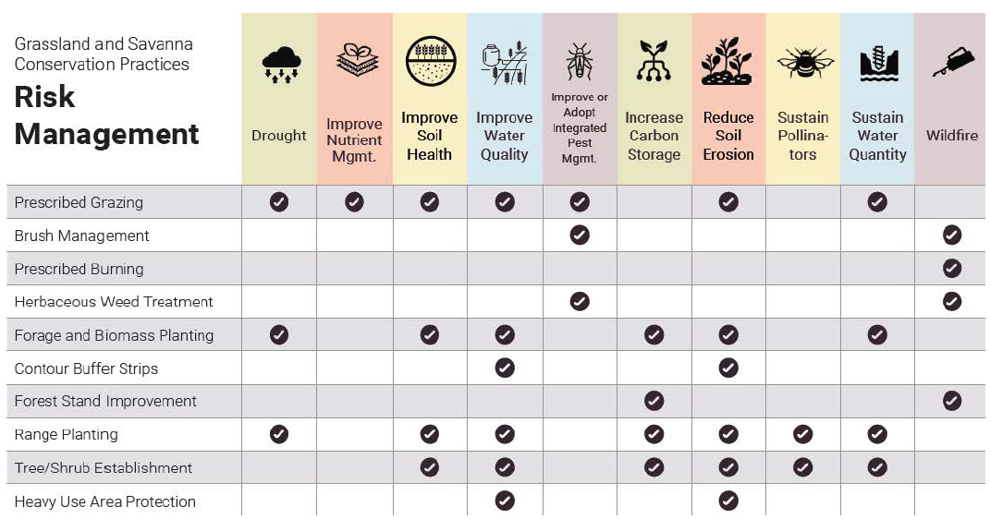
OUTCOMES ANTICIPATED
Notes:
The practices implemented within this framework will help producers reduce economic risks from drought to wildfire, and more!

Slide 13
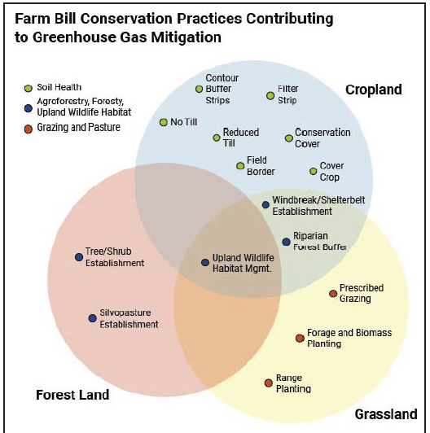
OUTCOMES ANTICIPATED
Notes:
35 practices that mitigate GHG across 3 land use groups = site-specific metrics to measure GHG mitigation contributed by this framework; NRCS will produce a second list for CPs that address climate adaptation needs.

Slide 14
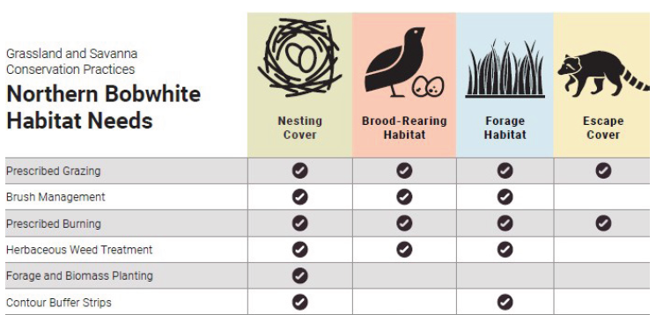
OUTCOMES ANTICIPATED
Notes:
Northern bobwhite habitat needs will be met, and this will have cascading effects for other wildlife – all in the name of a popular game bird. For example, in FY22 WLFW expenditures for the monarch butterfly multiplied by 7 times within the boundaries of the NOBO framework!

Slide 15
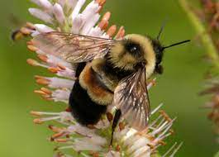
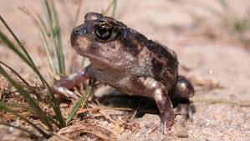
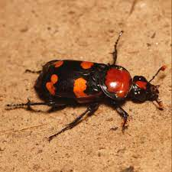
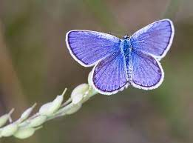
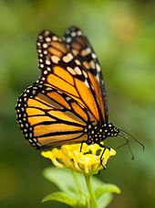
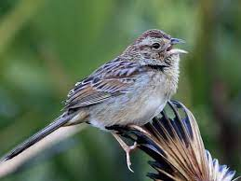
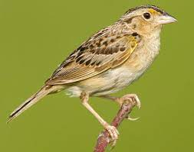
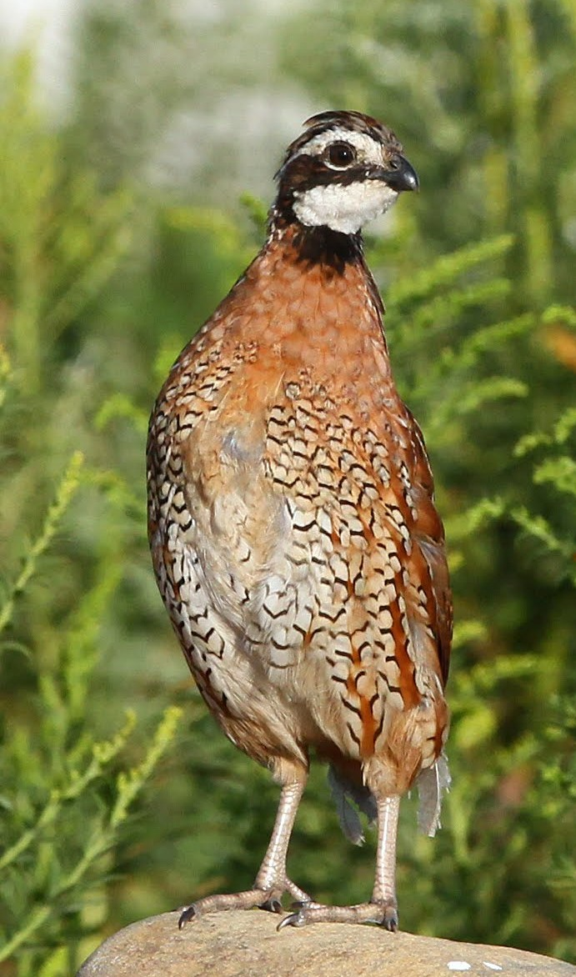
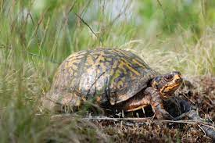
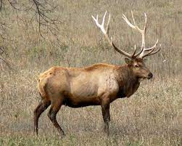
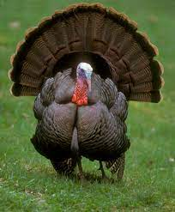
Multi-Species/Landscape Approach
Notes:
WLFW plans to coordinate with FWS and state wildlife agencies to identify grassland and savanna species that occur within the priority areas and could benefit from conservation practices; these co-benefits will be examined in outcomes assessments.

Slide 16
NEEDS ASSESSMENT 2021
Support for Framework Goals:
(to be coordinated with S&T, Tech
Centers, Public Affairs, Programs)
Training
Science
Communication
Technical Assistance/Staffing*
* NRCS ONLY
Notes:
Needs assessment survey to 24 NRCS state offices, plus partners; only NRCS was allowed to provide feedback on staffing needs

Slide 17
NEEDS ASSESSMENT
Top 5 Trainings Needs:
Northern Bobwhite Management
Economics of NWSGs
Prescribed Fire Planning
Management of NWSGs
Precision Agriculture Approaches

Slide 18
NEEDS ASSESSMENT
Top 5 Science Needs:
NOBO/Wildlife Response
Precision Agriculture Outcomes
Economics of NWSG Grazing
Management of NWSG & Outcomes
Fire & Wildlife Outcomes

Slide 19
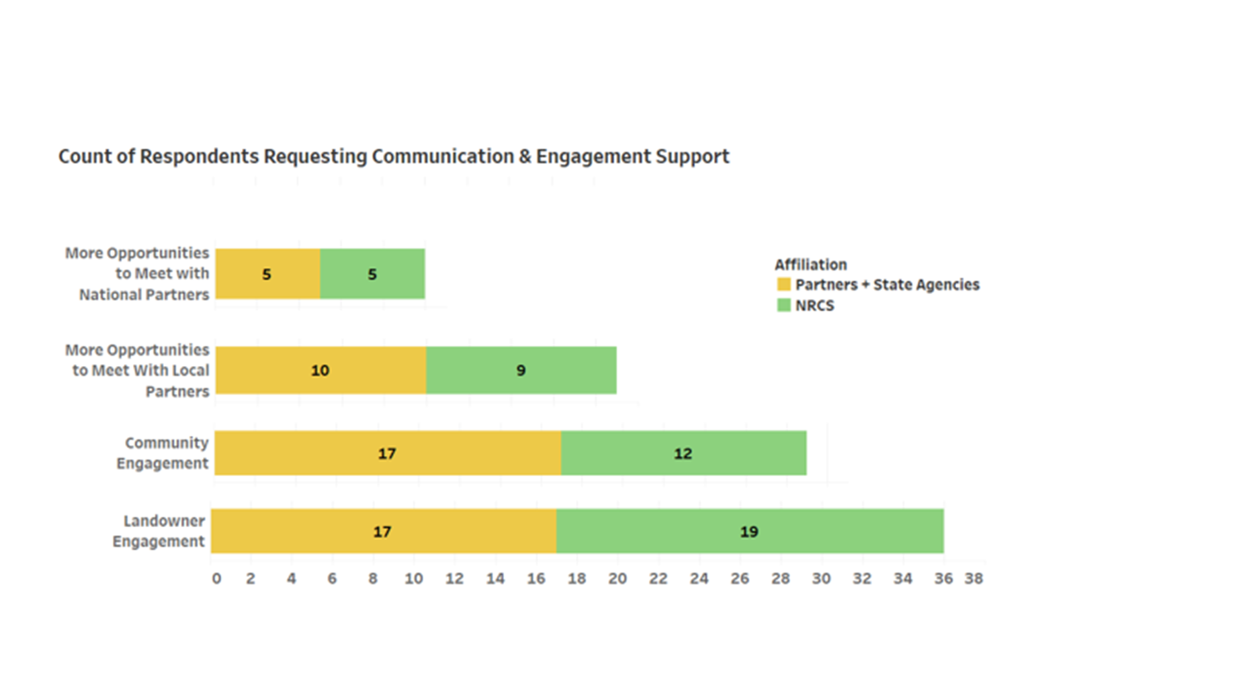
NEEDS ASSESSMENT
Top Communication Needs:

Slide 20
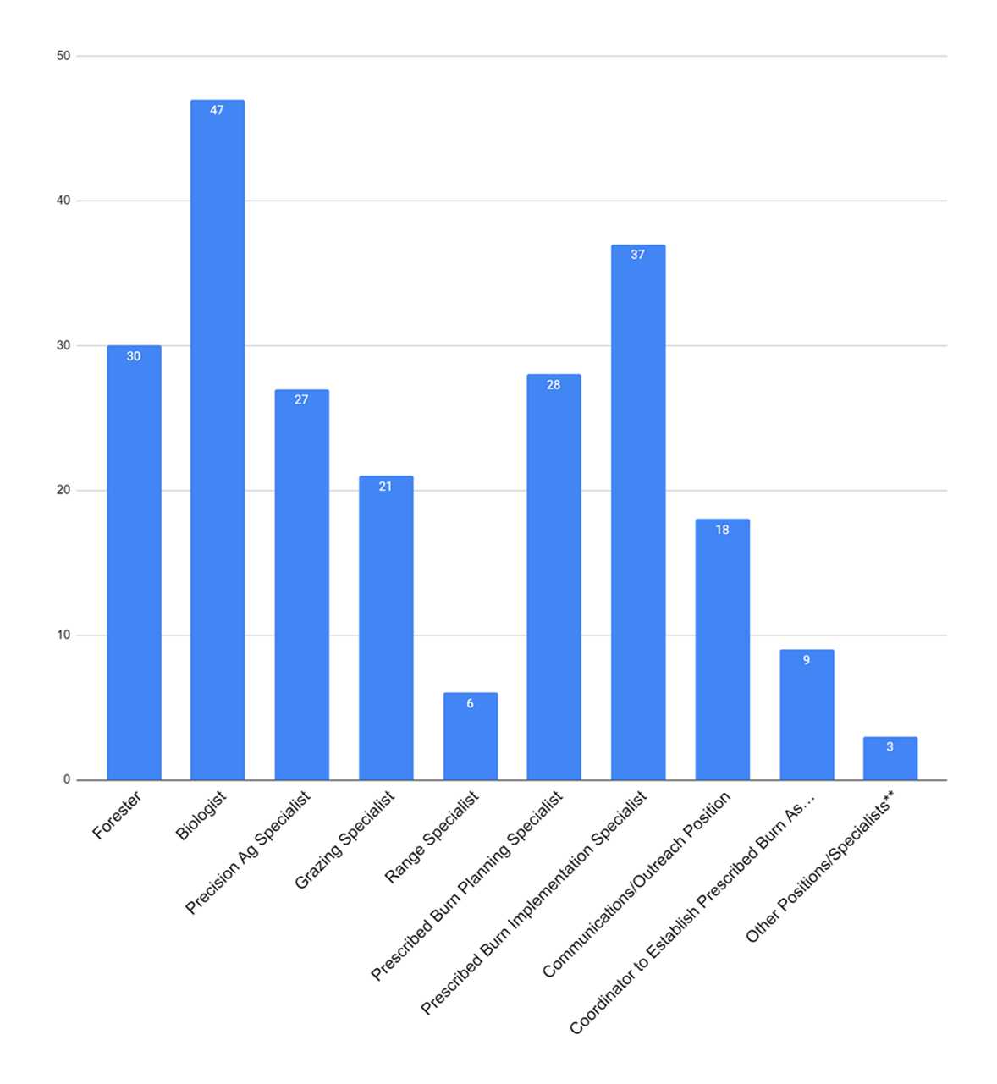
NEEDS ASSESSMENT Staffing Needs: 222
BIOLOGISTS
PRESCRIBED BURNING

Slide 21
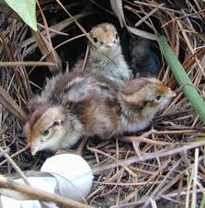
DISCUSSION

Slide 22
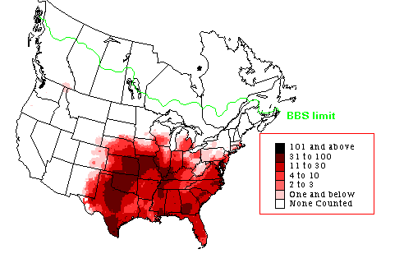
Range-wide Approach

